Slide 1
Introduction to Reinforcement Learning
And the first view on CIGAR Stability Models
Sy-Toan Ngo
Juin 23th, 2018

Slide 2
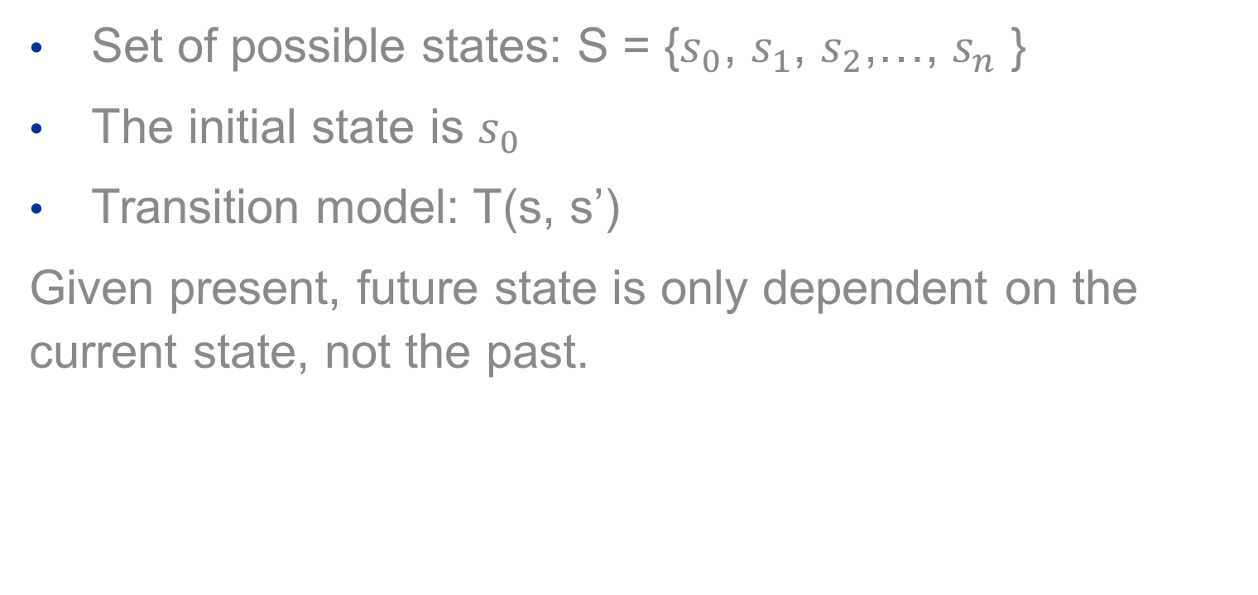
Markov property
Set of possible states: S = {$s_{0}$, $s_{1}$, $s_{2}$,…, $s_{n}$ }
The initial state is $s_{0}$
Transition model: T(s, s’)
Given present, future state is only dependent on the current state, not the past.
We can think of transition model as the impact from environment on the agent

Slide 3
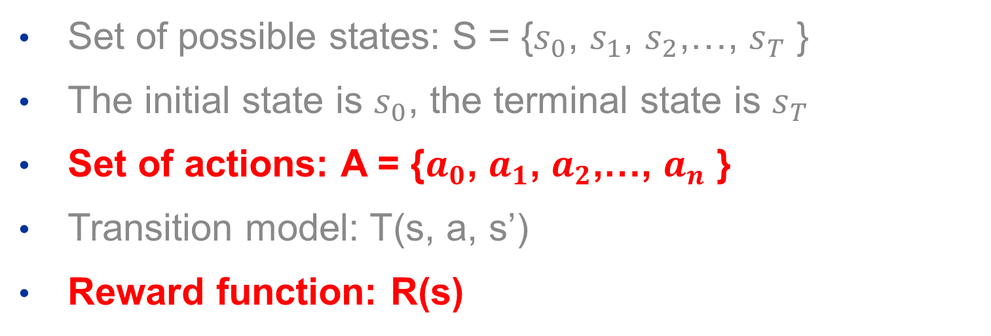
Markov Decision Process
Set of possible states: S = {$s_{0}$, $s_{1}$, $s_{2}$,…, $s_{T}$ }
The initial state is $s_{0}$, the terminal state is $s_{T}$
Set of actions: A = {$a_{0}$, $a_{1}$, $a_{2}$,…, $a_{n}$ }
Transition model: T(s, a, s’)
Reward function: R(s)
Transition model returns the probability of reaching state s’ from s under if the action a is executed.
-> even thought the agent wants to go to state s’ from s with action a, however it may get distracted.
For example, a cleaning machine wants to go from A to B, but a cat just appears and makes it go to C.
In Markov Decision Process, we assume that we know the transition model.

Slide 4
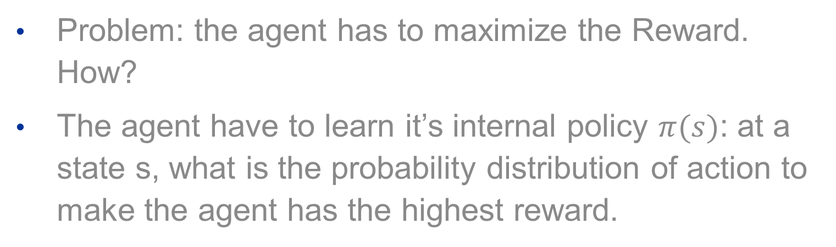
Markov Decision Process
Problem: the agent has to maximize the Reward. How?
The agent have to learn it’s internal policy $π(s)$: at a state s, what is the probability distribution of action to make the agent has the highest reward.
Optimal policy of all policies $π$ is $π^{∗}$ which returns the highest reward.

Slide 5
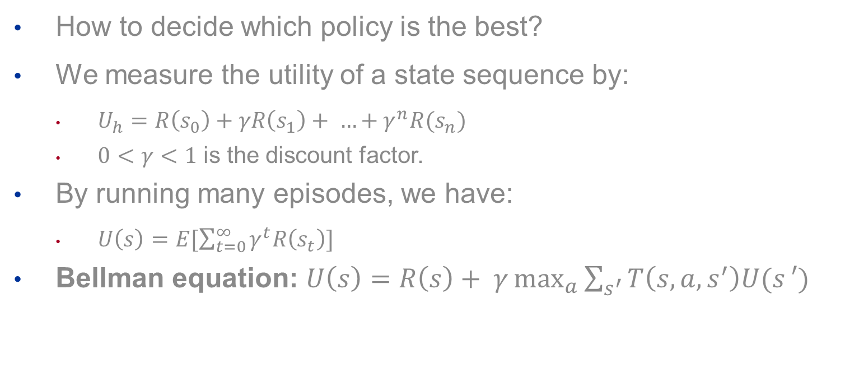
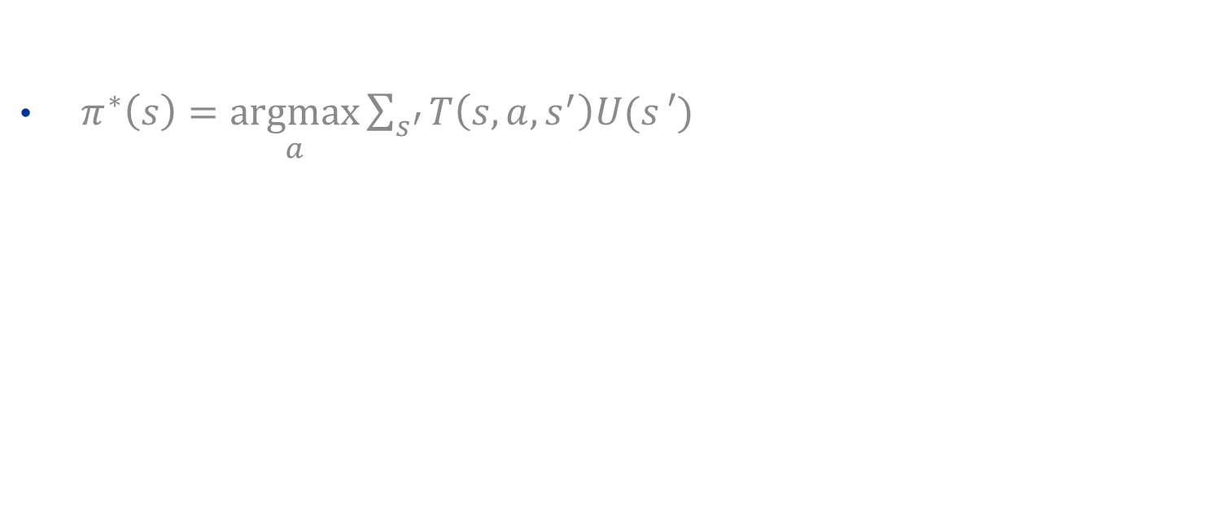
Markov Decision Process
How to decide which policy is the best?
We measure the utility of a state sequence by:
$U_{h}=R\left(s_{0}\right)+γR\left(s_{1}\right)+ …+γ^{n}R(s_{n})$
$0<γ<1$ is the discount factor.
By running many episodes, we have:
$U\left(s\right)=E[\sum_{t=0}^{∞}{γ^{t}R\left(s_{t}\right)}]$
Bellman equation: $U\left(s\right)=R\left(s\right)+ γ\max_{a}{\sum_{s^{′}}{T\left(s, a, s^{′}\right)U(s}′)}$
Now we could calculate the maximum utility at each state and which action is going to achieve the highest utility.
$π^{∗}\left(s\right)=\underset{a}{argmax}{\sum_{s^{′}}{T\left(s, a, s^{′}\right)U(s}′)}$
Notes:
Here we have U(s), so every state we have one Bellman equation -> n equation with n unknown, we could solve it but first have to get rid of max operator

Slide 6
Markov Decision Process
Value iteration algorithm – estimate utility
Initial state with random value (usually 0)
Update utility with Bellman equation
Run many episode, eventually utilities reach to an equilibrium, where utility of a state does not change much between 2 running time.
Notes:
Actually from value iteration algorithm, we could estimate the best policy, mapping each state to an action

Slide 7
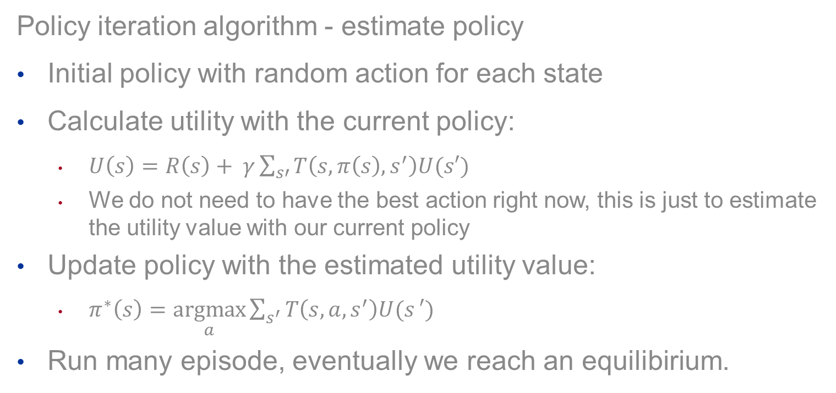
Markov Decision Process
Policy iteration algorithm - estimate policy
Initial policy with random action for each state
Calculate utility with the current policy:
$U\left(s\right)=R\left(s\right)+ γ\sum_{s′}{T\left(s,π\left(s\right), s^{′}\right)U(s′)}$
We do not need to have the best action right now, this is just to estimate the utility value with our current policy
Update policy with the estimated utility value:
$π^{∗}\left(s\right)=\underset{a}{argmax}{\sum_{s^{′}}{T\left(s, a, s^{′}\right)U(s}′)}$
Run many episode, eventually we reach an equilibirium.

Slide 8
MDP – Why is it not good enough?
We have to have a transition model – which give us the stochastic of the environment. However, in many real situations, we do not have this.
We call MDP is model-based reinforcement learning.
Move on, we need to develop a new method, without assuming a transition model, which called model-free reinforcement learning.
(transition-model-free RL)

Slide 9
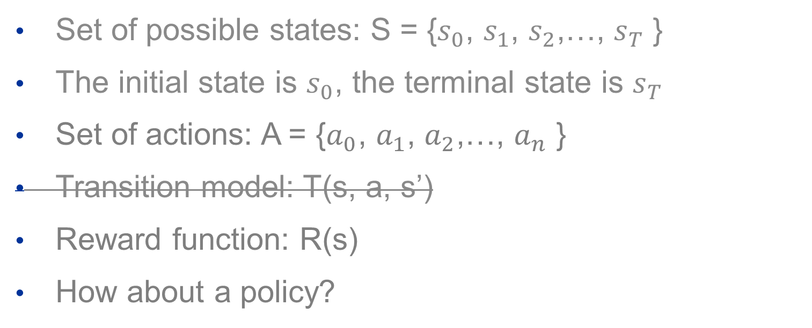
Model-free RL
Set of possible states: S = {$s_{0}$, $s_{1}$, $s_{2}$,…, $s_{T}$ }
The initial state is $s_{0}$, the terminal state is $s_{T}$
Set of actions: A = {$a_{0}$, $a_{1}$, $a_{2}$,…, $a_{n}$ }
Transition model: T(s, a, s’)
Reward function: R(s)
How about a policy?

Slide 10
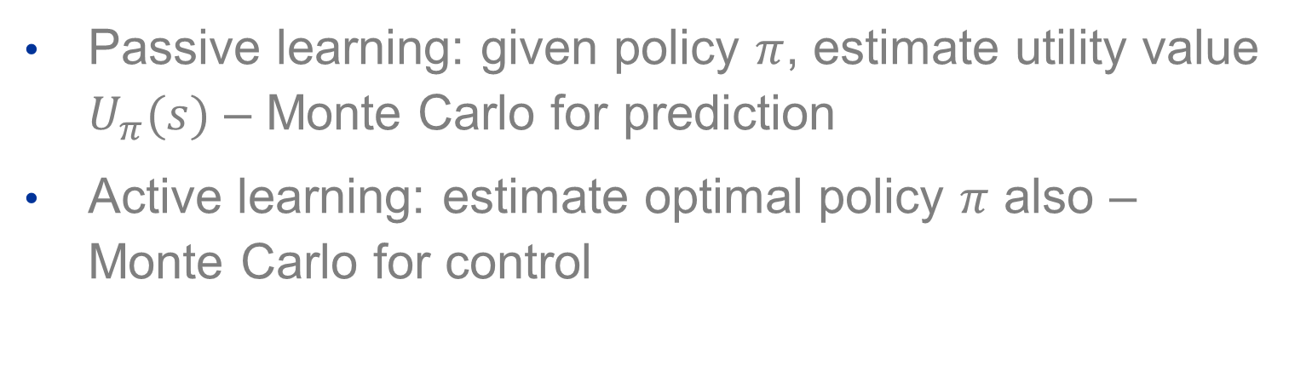
Model-free RL – Passive & Active Learning
Passive learning: given policy $π$, estimate utility value $U_{π}(s)$ – Monte Carlo for prediction
Active learning: estimate optimal policy $π$ also – Monte Carlo for control
Monte Carlo Method
Induce a bit of randomness to solve the problem that might be deterministic in principle.

Slide 11
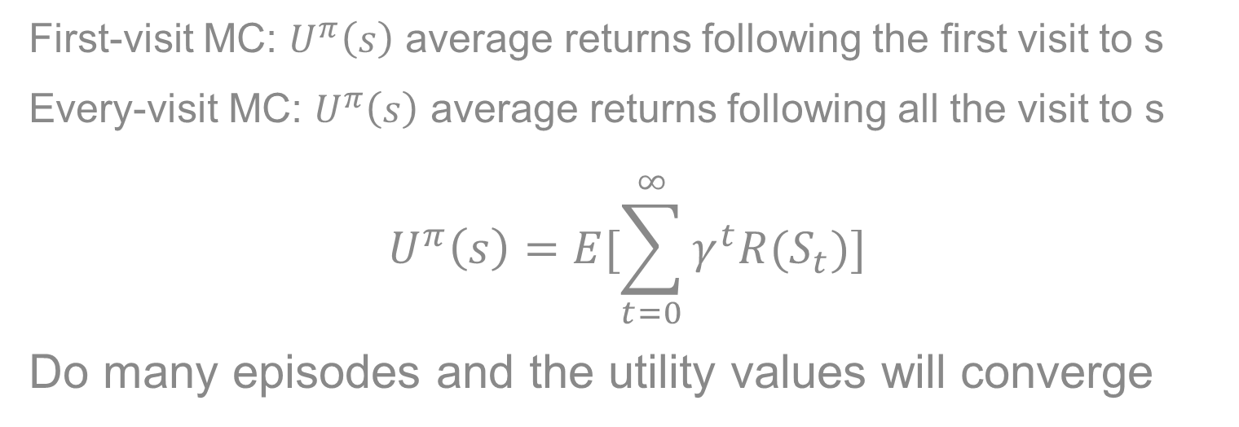
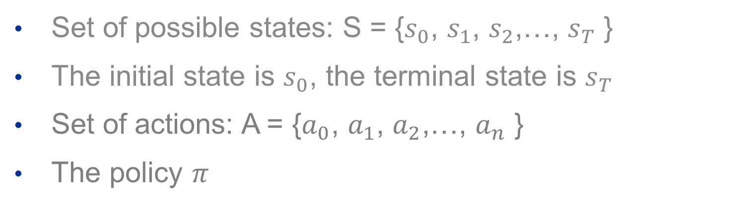
Monte Carlo for Prediction – Passive Learning
Set of possible states: S = {$s_{0}$, $s_{1}$, $s_{2}$,…, $s_{T}$ }
The initial state is $s_{0}$, the terminal state is $s_{T}$
Set of actions: A = {$a_{0}$, $a_{1}$, $a_{2}$,…, $a_{n}$ }
The policy $π$
First-visit MC: $U^{π}\left(s\right)$ average returns following the first visit to s
Every-visit MC: $U^{π}\left(s\right)$ average returns following all the visit to s
$$U^{π}\left(s\right)=E[\sum_{t=0}^{∞}{γ^{t}R(S_{t})}]$$
Do many episodes and the utility values will converge

Slide 12
Monte Carlo for Prediction – Passive Learning
Until now, we could estimate the utility value under a policy.
Can we do it better? Yes -> Active Learning

Slide 13
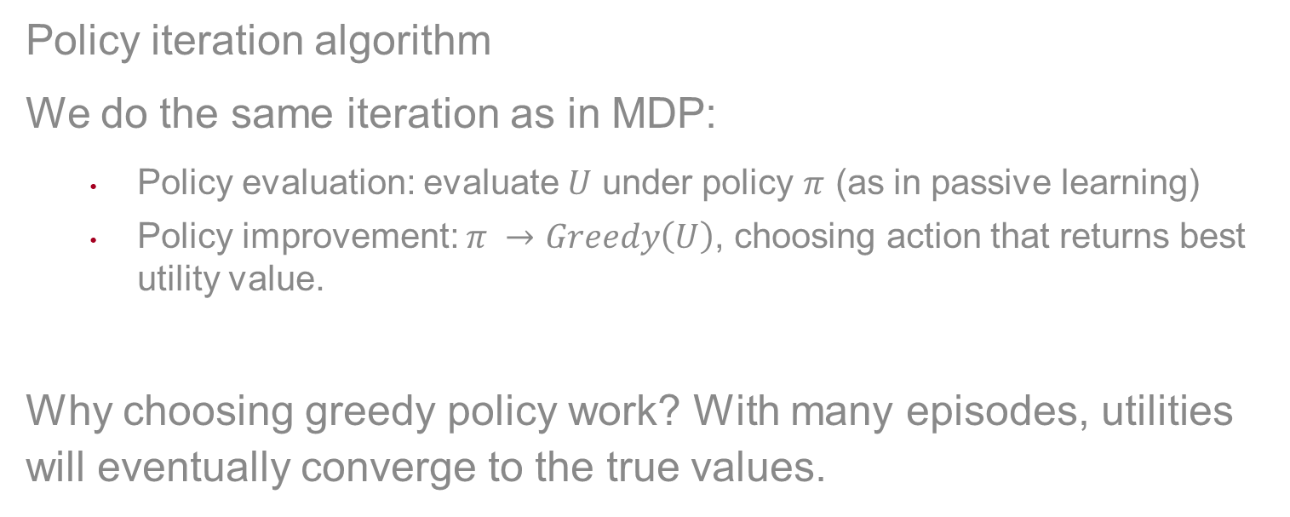
Monte Carlo Control – Active Learning
Policy iteration algorithm
We do the same iteration as in MDP:
Policy evaluation: evaluate $U$ under policy $π$ (as in passive learning)
Policy improvement: $π →Greedy\left(U\right)$, choosing action that returns best utility value.
Why choosing greedy policy work? With many episodes, utilities will eventually converge to the true values.

Slide 14
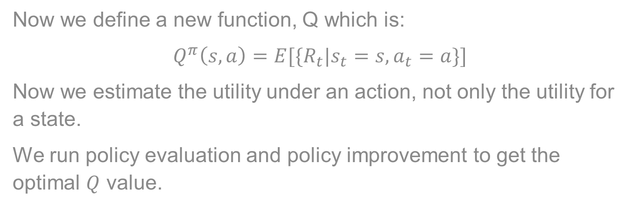
Q-function
Now we define a new function, Q which is:
$$Q^{π}\left(s,a\right)=E[\{R_{t}|s_{t}=s, a_{t}=a\}]$$
Now we estimate the utility under an action, not only the utility for a state.
We run policy evaluation and policy improvement to get the optimal $Q$ value.

Slide 15
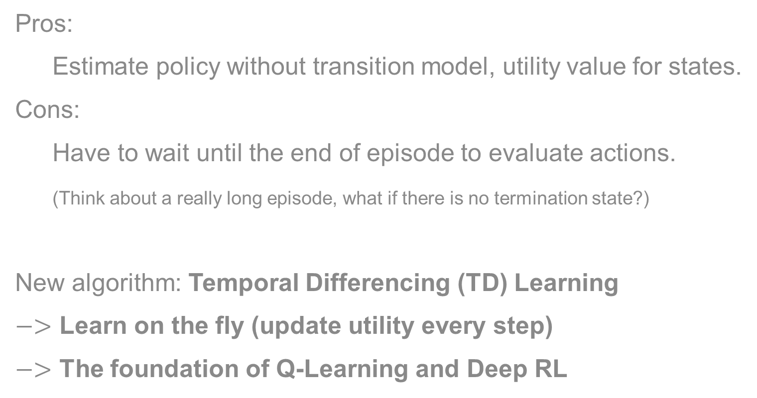
Monte Carlo Method – is it still not good enough?
Pros:
Estimate policy without transition model, utility value for states.
Cons:
Have to wait until the end of episode to evaluate actions.
(Think about a really long episode, what if there is no termination state?)
New algorithm: Temporal Differencing (TD) Learning
$−>$ Learn on the fly (update utility every step)
$−>$ The foundation of Q-Learning and Deep RL

Slide 16
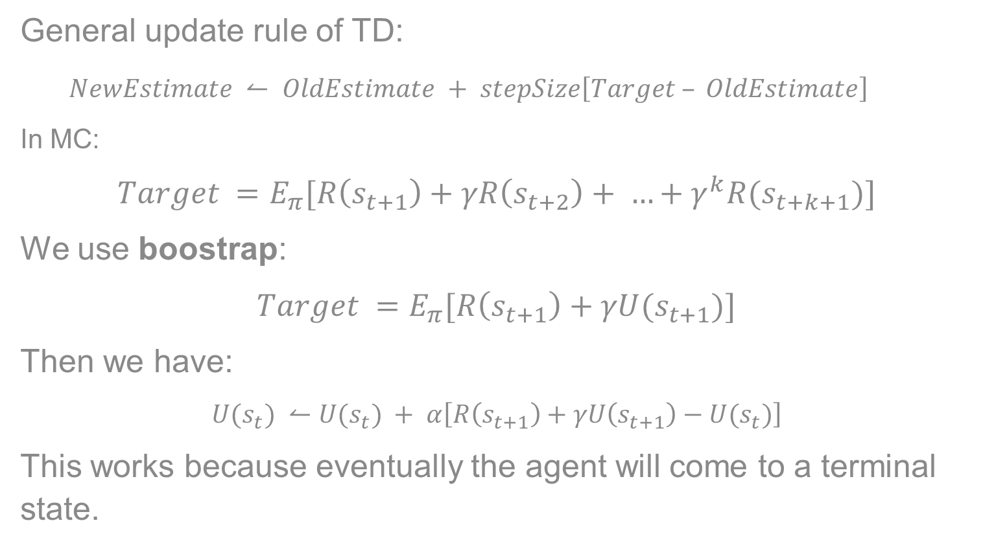
Temporal Differencing Learning – Passive Learning
General update rule of TD:
$NewEstimate ↼ OldEstimate + stepSize\left[Target – OldEstimate\right]$
In MC:
$$Target =E_{π}[R\left(s_{t+1}\right)+γR\left(s_{t+2}\right)+ …+γ^{k}R(s_{t+k+1})]$$
We use boostrap:
$$Target =E_{π}[R\left(s_{t+1}\right)+γU(s_{t+1})]$$
Then we have:
$$U(s_{t}) ↼U(s_{t}) + α\left[R\left(s_{t+1}\right)+γU\left(s_{t+1}\right)−U(s_{t})\right]$$
This works because eventually the agent will come to a terminal state.

Slide 17
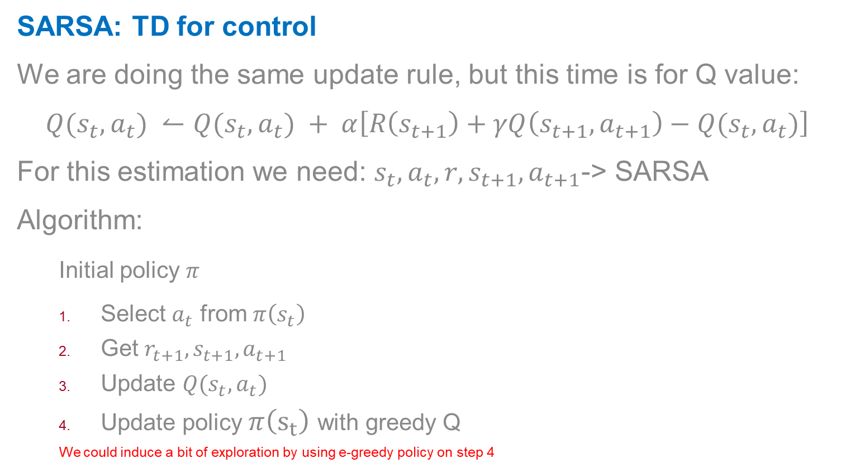
Temporal Differencing Learning – Active Learning
SARSA: TD for control
We are doing the same update rule, but this time is for Q value:
$$Q(s_{t}, a_{t}) ↼Q(s_{t}, a_{t}) + α\left[R\left(s_{t+1}\right)+γQ\left(s_{t+1},a_{t+1}\right)−Q(s_{t}, a_{t})\right]$$
For this estimation we need: $s_{t}, a_{t},r,s_{t+1},a_{t+1}$-> SARSA
Algorithm:
Initial policy $π$
Select $a_{t}$ from $π\left(s_{t}\right)$
Get $r_{t+1}, s_{t+1}, a_{t+1}$
Update $Q(s_{t}, a_{t})$
Update policy $π\left(s_{t}\right)$ with greedy Q
We could induce a bit of exploration by using e-greedy policy on step 4

Slide 18

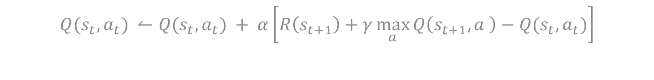
Temporal Differencing Learning – Active Learning
Q-learning: off-policy control
In SARSA, we use an initial policy then update Q value and the policy on the fly, this is called on-policy control.
In off-policy control, we update Q value but it does not depend on the policy.
$$Q(s_{t}, a_{t}) ↼Q(s_{t}, a_{t}) + α\left[R\left(s_{t+1}\right)+γ\max_{a}{Q\left(s_{t+1},a \right)}−Q(s_{t}, a_{t})\right]$$
$$Target\left(s^{′}\right)= \left[R\left(s,a,s′\right)+γ\max_{a}{Q\left(s′,a′\right)}\right]$$

Slide 19
Is standard TD is good enough?
We have to keep a table of q-values (Tabular Q-learning), for each state we have a Q-value for each action.
Is there a way of generalize the Q-value for states and actions?
-> Using a function approximation
-> Deep reinforcement learning

Slide 20
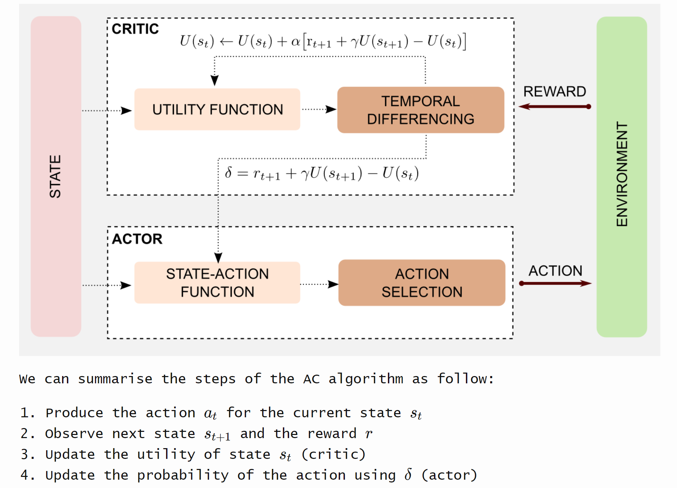
Action – Critic Methods

Slide 21
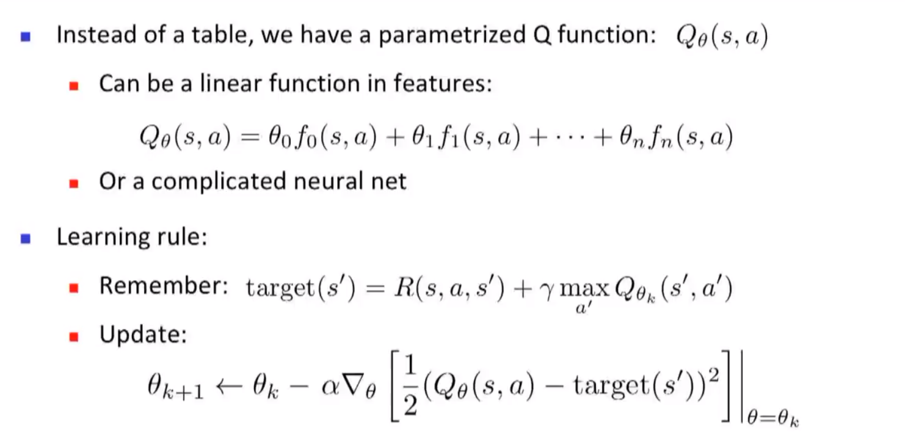
Approximate Q-learning

Slide 22
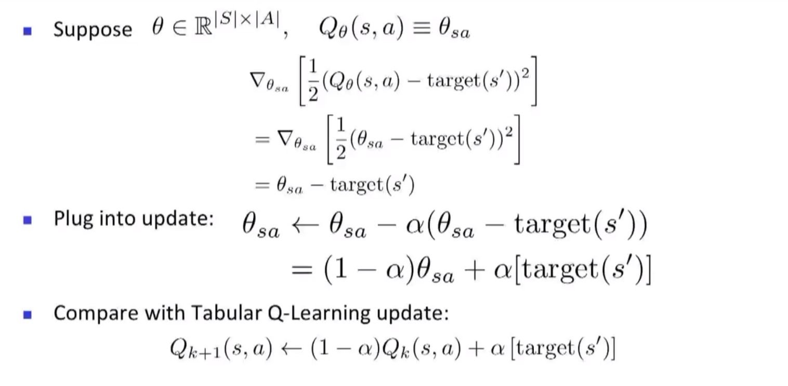
Approximate Q-learning

Slide 23
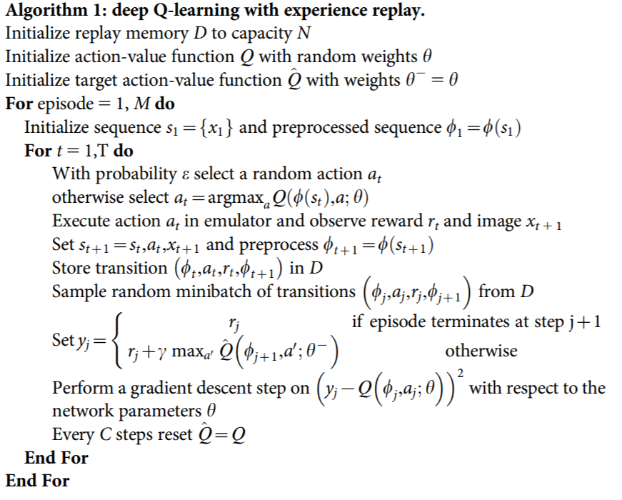
Deep Q Network

Slide 24
CIGAR Stability Model
Action space
State space
Reward

